Slide 1
Stat 453 Project - Stock Price Prediction
Group 6: Jinyoung Han, Gyuho Shim, Shuwei Liu

Slide 2
Stock Price Prediction
Introduction
Data
Work process/Methods
Analysis
Conclusion (+things that could be fixed?)

Slide 3
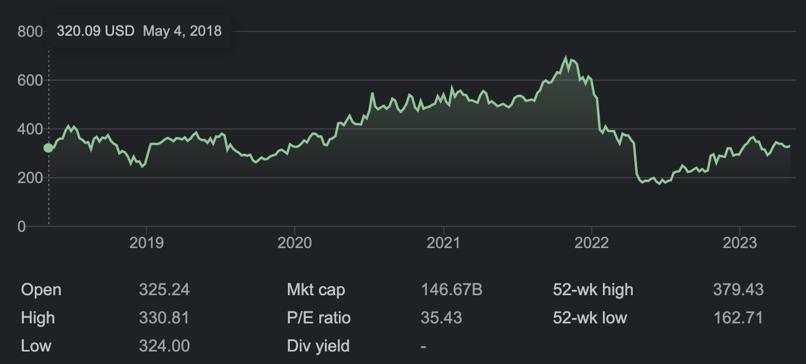
Introduction
Motivation: Enhance accuracy of predictions of the future value of companies to maximize the efficiency of investment
Focused one specific company’s stock price and tested them by one well-known methodology of deep learning, RNN
Chose Netflix as an adequate source due to its popularity, accessibility, credibility, and dynamicity of dataset
Can be later generalized to any extent of companies

Slide 4
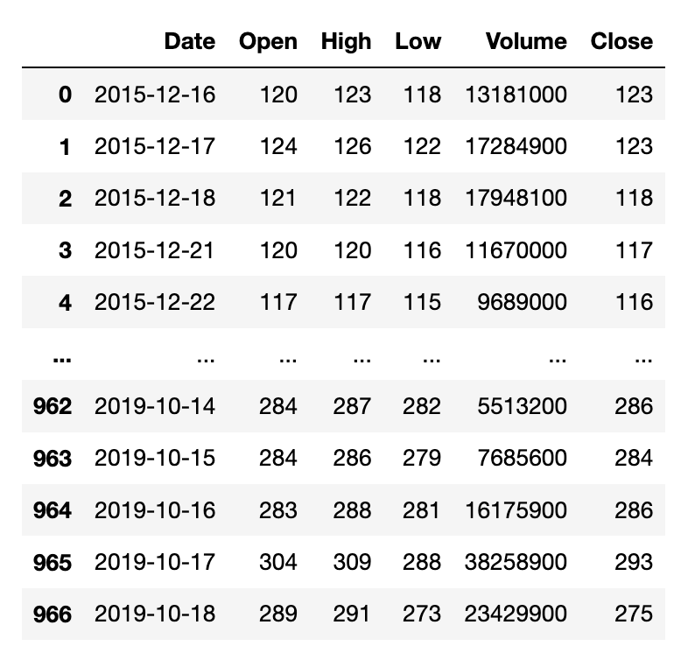
Data
Extracted from Kaggle
6 Columns x 967 rows
Date
Date
2015.12.16 ~ 2019.10.18
Open
price at which the financial security opens in the market when trading begins
High
Highest price at which a stock traded during a period.
Low
minimum price of a stock in a given period
Close
Closing price generally refers to the last price at which a stock trades during a regular trading session
Adj Close
The adjusted closing price amends a stock's closing price to reflect that stock's value after accounting for any

Slide 5
Work Process/Methods
RNN(Recurrent Neural Network)
Activation Function: ReLU
Each layer is computed by ReLU and passed in as input to the next layer
Epoch 200
Batch Size 32
5 layers

Slide 6
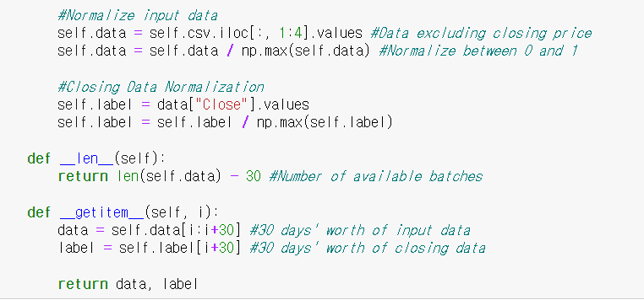
Work Process/Methods
Data Normalization
Normalize all data to be between 0 and 1
Calculate the number of batches available by subtracting 30 days from the total data set length
Get 30 days’ worth of input and closing data

Slide 7
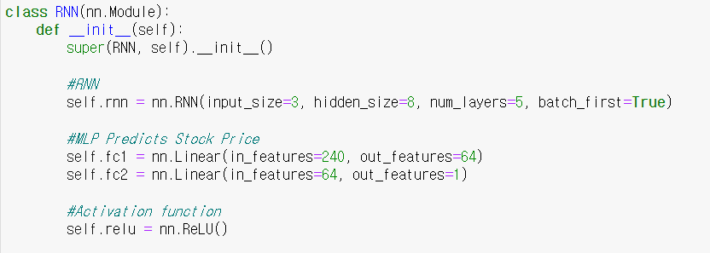
Work Process/Methods
Define RNN layer
input_size=3 (Open, High, Low)
num_layers=5
To avoid gradient loss or gradient explosion from too many or too less layers
ReLU for activation function

Slide 8
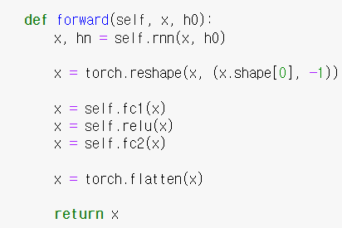
Work Process/Methods
Define the net propagation of the RNN model
X returns the hidden state of the last RNN layer
Convert predicted closing prices to one-dimensional vectors

Slide 9
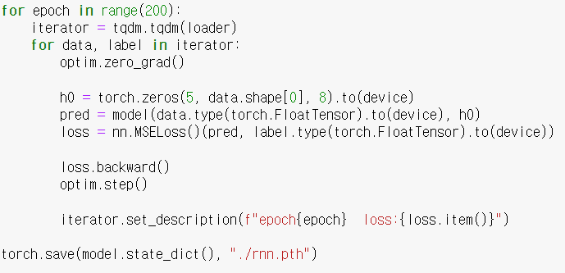
Work Process/Methods
Pred: Get the predicted results from the model
Loss: Compare actual data with the model’s predictions and calculate errors
Optimize
Save the model

Slide 10
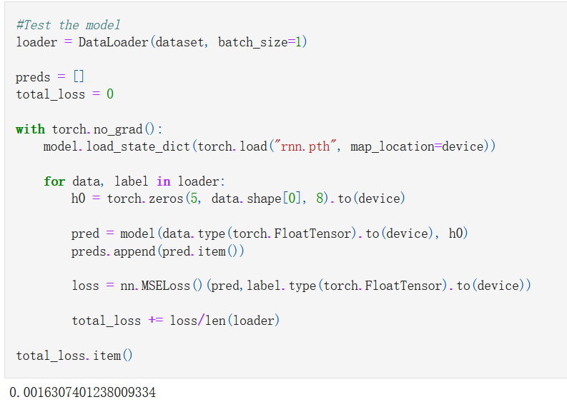
Analysis
Small MSE
High accuracy and Predictive power

Slide 11
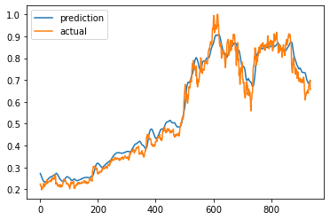
Conclusion
Used RNN to predict stock prices of Netflix
Performed well after training hyperparameters and model optimization

Slide 12
Future Work
Generalization :
Expanding the dataset: Dataset of different companies can be collected
Cross-industry validation
Feature selection: Different features in different industries/companies

Slide 13
THANK YOU
Group 6: Jinyoung Han, Gyuho Shim, Shuwei Liu

